Slide 1



Introduction to Statistics for Data Science

Slide 2
Learning Objectives
At the end of the class, participants should be able to :
Define and differentiate between Data Science, Data analysis and Data Engineering.
Know the difference between descriptive, prescriptive, diagnostic and predictive analytics.
Know the difference between Structured, Semi-structured and Unstructured data.
Know some of the basic application of Data Science to business.
Know some of the tools or languages that cut across the field of data.
Know the different aspects of statistics as it applies to data and inference generation from data.

Slide 3
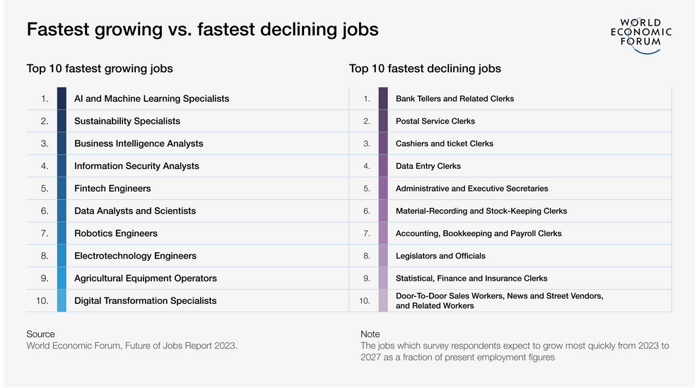

Slide 4
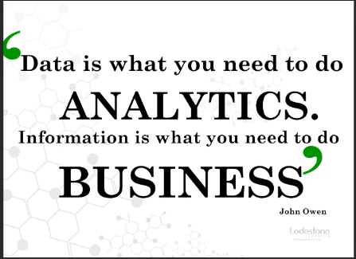

Slide 5
Scenario 1
Imagine you're a detective trying to solve a mystery. You have clues scattered everywhere, but you need to figure out how they all fit together to solve the case. That's essentially what data scientists do!

Slide 6
Scenario 2
Picture yourself as a product manager who just launched a new gadget, but sales are dismal. You’re a detective with a case: what went wrong? Your clues are everywhere—online reviews, social media buzz, and pre-launch survey responses. By analyzing them, you uncover that customers hate the confusing instructions, so you roll out a clearer guide and turn things around.

Slide 7
Introduction
A data scientist is a sharp-eyed detective stepping into a bustling, chaotic crime scene. The room is filled with scattered clues—fingerprints on a glass, a crumpled note, a trail of muddy footprints, maybe even a grainy security camera feed. Their job? To make sense of it all, connect the dots, and uncover the truth behind the mystery. That’s exactly what a data scientist does, but instead of a dimly lit alley or a smoking gun, their crime scene is a sprawling digital landscape of numbers, text, images, and patterns.

Slide 8
What is Data Science?
Data science is an interdisciplinary field that involves extracting insights and knowledge from structured and unstructured data using scientific methods, processes, algorithms, and systems. It entails gathering, cleaning, analyzing, and interpreting data in order to gain insights and knowledge that can assist organizations in making informed decisions.
Data science involves the part of predictive analytics using Machine Learning and related fields.

Slide 9
Statistics Analysis
On a daily basis, statistical analysis and probability have an impact on our lives. Statistics is used to forecast the weather, replenish retail shelves, assess the state of the economy, and much more. Used in a variety of professional fields, statistics has the power to derive valuable insights and solve complex problems in business, science, and society. Without hard science, decision making relies on emotions and gut reactions. Statistics and data take precedence over intuition, inform decisions, and reduce risk and uncertainty.

Slide 10
Component of Data Science
Problem Definition and Understanding.
Data Collection.
Data Cleaning and processing.
Exploratory Data Analysis (EDA).
Feature Engineering.
Modelling
Model Evaluation
Deployment
Monitoring and Maintenance.
Visualization and Communication.

Slide 11
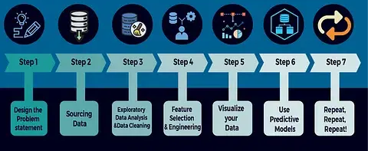
Data Science Process Flow

Slide 12
Areas of Data Science
Data Collection and Preparation
What It Is: Gathering raw data and getting it ready for analysis—think of it as collecting clues at a crime scene and organizing them for investigation.
Exploratory Data Analysis (EDA)
What It Is: Digging into the data to spot initial patterns, trends, or anomalies—like a detective sifting through evidence to form early theories.
Statistical Analysis and Probability
What It Is: Applying math to measure relationships, test hypotheses, and estimate likelihoods—akin to a detective using forensics to confirm suspicions.

Slide 13
Areas of Data Science
Machine Learning
What It Is: Teaching computers to learn from data and make predictions or decisions—like training a detective’s assistant to spot suspects automatically.
Data Visualization and Communication
What It Is: Turning complex findings into clear, compelling stories—like a detective presenting the solved case to the jury.
Big Data and Data Engineering
What It Is: Managing and processing massive datasets—like a detective handling a city-wide investigation with endless files.

Slide 14
Areas of Data Science
Domain Expertise and Business Analytics
What It Is: Applying data skills to specific industries or problems—like a detective specializing in financial crimes.
Artificial Intelligence (AI) and Deep Learning
What It Is: Pushing beyond basic machine learning to mimic human-like intelligence—like a detective’s AI sidekick solving cases solo.

Slide 15
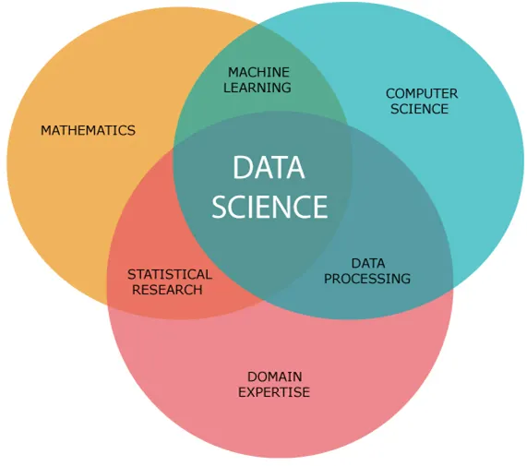
Skills of a Data Scientist

Slide 16
Tools for Data Science
Programming Languages
SQL
Data manipulation and analysis libraries
Machine learning frameworks
Data visualization tools
Cloud platforms
Version control system
Containers
Databases

Slide 17
Data Analysis
Data analysis is concerned with extracting information from data by cleaning and transforming it. It overlaps with Data Science in many areas, such as presenting insights to the team and creating visualizations. However, the Machine Learning section is not included.

Slide 18
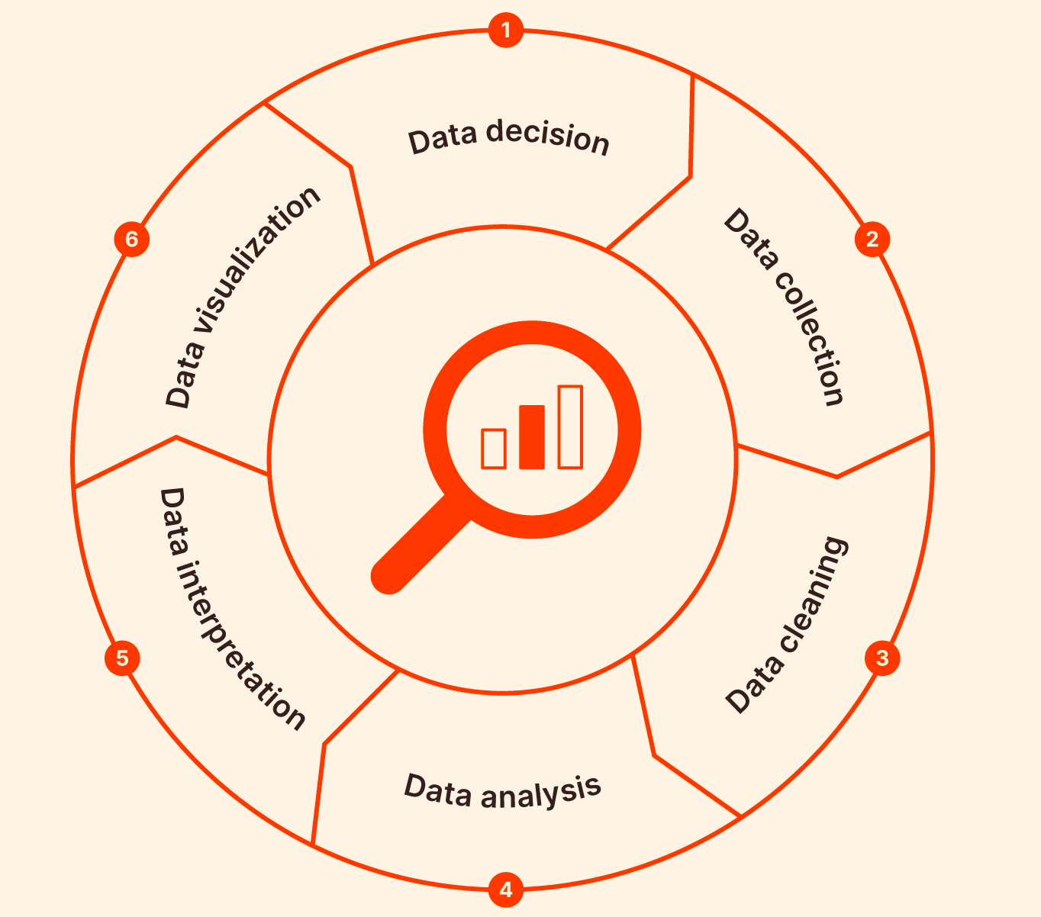
Data Analysis Process

Slide 19
Tools for Data Analysis
Data visualization tools
SQL
Programming tools
Data manipulation and analysis libraries
Microsoft Excel

Slide 20
Data Engineering
Data Engineering is concerned with assisting data scientists and data analysts in their daily tasks. It entails building data pipelines, designing architectures, storing data efficiently, and making massive amounts of data easily accessible to data scientists and analysts. It also entails utilizing tools to unearth hidden insights in your data.

Slide 21
Type of Data Engineering Pipeline
Extract Transform Load
The ETL process (Extract, Transform, Load) is a fundamental procedure in data management, particularly in data warehousing, where large volumes of data from various sources are processed and integrated. It involves three key steps
Extract
Transform
Load

Slide 22
Data Engineering
Programming tools
Data engineering frameworks
Data storage and warehousing
Cloud platforms
Version control
Containers
Data quality tools
Data governance tools

Slide 23
Types of Statistical Analysis
Statistical analysis is broadly being divided into;
Descriptive Statistics.
Predictive Statistics.
Diagnostic Statistics
Prescriptive Statistics

Slide 24
Descriptive Analytics
This summaries and organizes data to describe what’s happening. It majorly focuses on two goals which are;
Measure of Central tendency
Measure of Dispersion
Frequency DIstribution

Slide 25
Measure of Central Tendency
This techniques describe the distribution’s central position for a given dataset—think of it as pinpointing the heart of the dataset.. These technique include;
Mean
Media
Mode

Slide 26
Measure of Dispersion
This technique describe how much the data varies—like mapping how far the clues are scattered from the center. Examples of statistical technique include;
Range
Variance
Standard deviation
IQR

Slide 27
Let us consider two hypothetical pizza restaurants. They both advertise a 20-minute average delivery time. When we're hungry, they both sound delicious! This equivalence, however, can be misleading! In that case, there is the need to analyze their variability to determine which restaurant we should order from when we are hungry. Assume we investigate their delivery times, calculate the variability for each location, and discover that their variabilities differ. How significant is this difference in delivering pizza to customers on time?
The graphs below display the distribution of delivery times and provide the answer. The restaurant with more variable delivery times has the broader distribution curve.

Slide 28
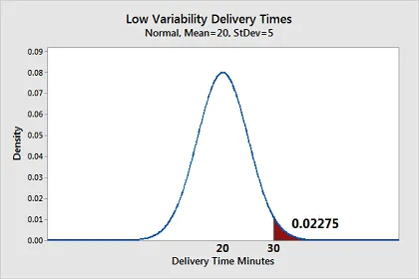
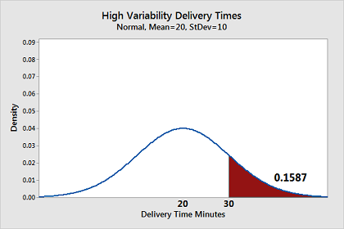

Slide 29
Frequency Distribution
This counts how often values appear and how they’re shaped—like tallying witness statements.
Frequency Tables: Lists values and their counts.
Histograms: Visual bars showing frequency across ranges.
Percentiles: What value a percentage of data falls below.

Slide 30
Diagnostic Data Analytics
Diagnostic analytics is a form of data analysis that focuses on identifying the causes or reasons behind certain events or outcomes. It goes beyond descriptive analytics, which tells us what happened, by digging deeper into the "why" behind an event. This type of analytics is used to find patterns, relationships, and insights within data to understand the underlying factors that led to certain behaviors, trends, or anomalies.

Slide 31
Predictive Analytics
Predictive analytics is the process of predicting and forecasting what will happen in the future based on historical and current data. It aids in determining which decisions to make in order to influence the outcome of future events. This is also part of the day-to-day work of a data scientist.

Slide 32
Prescriptive Data Analytics
Prescriptive analytics is the most advanced type of data analytics, focusing on recommending specific actions or decisions to achieve desired outcomes based on the insights derived from data. It combines techniques from descriptive, diagnostic, and predictive analytics to suggest optimal courses of action, helping organizations or individuals make informed decisions.

Slide 33
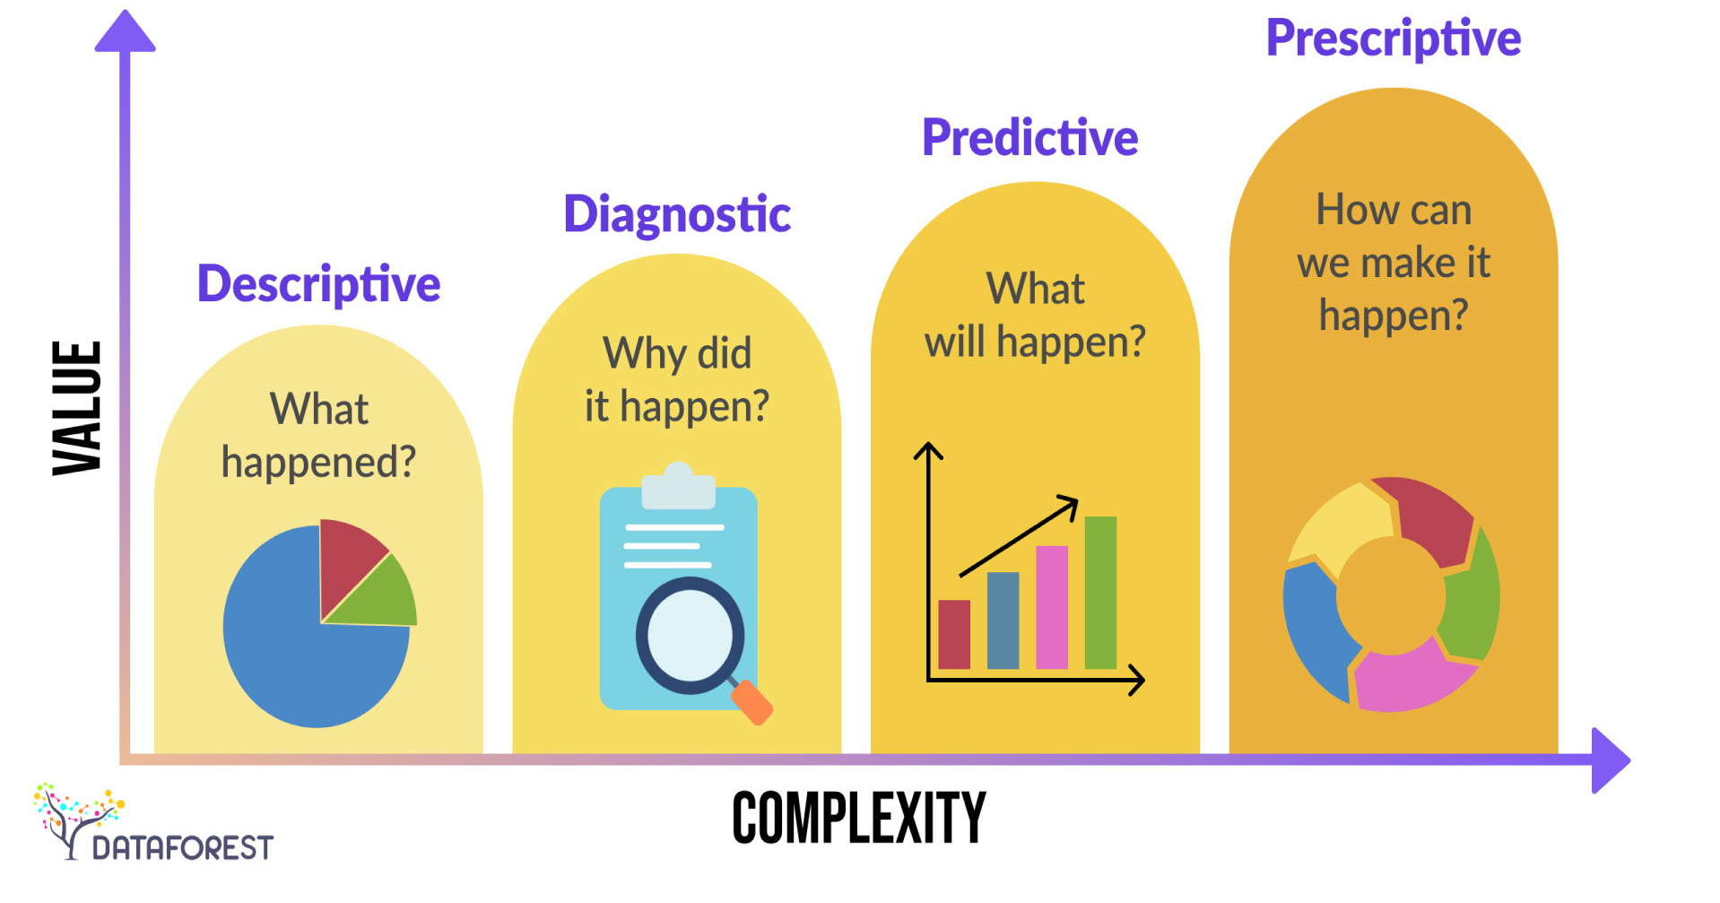

Slide 34
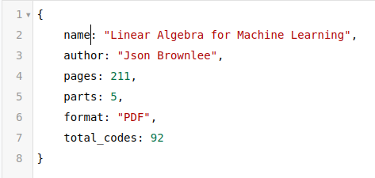
Structure of Data
This is a type of data, that follows a fixed, pre-established format and organization. It’s typically housed in relational databases, making it straightforward to manage and analyze within data science.
Semi-Structured Data: While it has a set format and structure, it isn’t stored in relational databases.
Examples:
JSON (JavaScript Object Notation)

Slide 35

Structure of Data
Unstructured Data: This data lacks a defined format or organization, posing significant challenges for processing in data science.
Examples:
Images
Videos
Audio files
Speech recordings

Slide 36
Application of Data Science
Asides the business application of data science to innovation and invention, it can also be applied to health and other aspects of life which is the reason why it is multi-disciplinary.
Drug discovery
Predictive medicine
Medical imaging
Financial forecasting
recommender models

Slide 37
Data Science life cycle
The Data Science life cycle involves the following steps:
Problem Understanding: It all starts with understanding the problem at hand, the questions, and the answers we are trying to discover from the dataset at hand.
Data Acquisition: Data Acquisition, as the name suggests, is about retrieving the data with the help of Data Engineers where required. It also consolidates all of the data required to answer the question or to solve the problem at hand.

Slide 38
Data Science life cycle
Data Wrangling: Data wrangling is about using knowledge to preprocess data. It involves looking for missing values and asking business questions like why they are missing. Furthermore, it uses knowledge to give shape to the dataset appropriate for visualizations and to support the coming steps in the life cycle.
Data Exploration: Data Exploration is about visualization and other statistical measures to see whether the questions we asked, in the beginning, are being answered or not? The data analyst’s job ends here.
Feature Engineering and Selection: It is a preprocessing step before modeling in both Machine Learning and Deep Learning. We will look into these fields in the coming sections. It has similar steps to Data Wrangling apart from some algorithms for Feature Selection and transformation.

Slide 39
Data Science life cycle
Modelling: Modeling is the process that uncovers the meaning of the data. It is about capturing underlying trends and the data’s behavior to make the model, which can be used for predictive analytics as described in the previous section.
Deployment: After we build the model we’ll deploy it in the most efficient and optimized manner so that it can be used by real users. It can be deployed on mobile applications and web applications.
Monitoring: After we have deployed the model, we will want to monitor it. Monitoring is about familiarizing the model with the new dataset and tracking the number of requests that the model receives. It also involves making changes to the analysis and starting over if required.

Slide 40
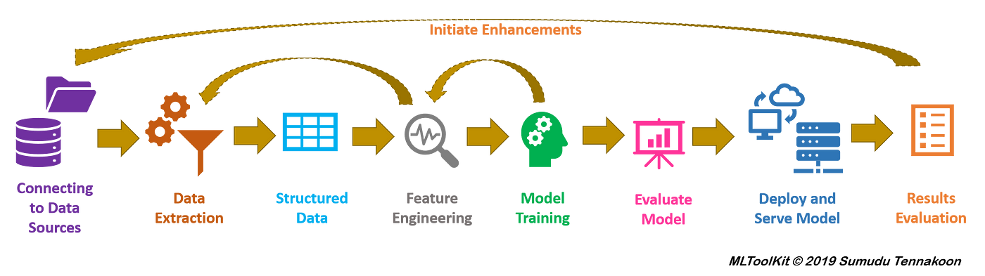
Machine Learning Structure Flow

Slide 41
Statistical Terms
Population: the source of data to be collected.
Sample: a portion of the population.
Variable: any data item that can be measured or counted.
Quantitative analysis (statistical): collecting and interpreting data with patterns and data visualization.
Qualitative analysis (non-statistical): producing generic information from unstructured forms of media.

Slide 42
Statistical Terms
Descriptive statistics: characteristics of a population.
Inferential statistics: predictions for a population.
Central tendency (measures of the center): mean (average of all values), median (central value of a data set), and mode (the most recurrent value in a data set).
Measures of the spread:
Range: the distance between the highest and lowest value in a data set.
Variance: the average distance between a data point and its mean value.
Standard deviation: the dispersion of a data set from the mean.

Slide 43
Statistical terms
Probability distributions: Probability is defined as the likelihood of something occurring, expressed as a simple "yes" or "no" percentage. When the weather forecast predicts a 30% chance of rain, it also means there is a 70% chance it will not rain.

Slide 44
Quantitative Data
Quantitative data are simple set of information that can be quantified, it can be counted or measured, and given a numerical value—such as length in centimeters or revenue in dollars. Quantitative data tends to be structured in nature and is suitable for statistical analysis. Examples include revenue, Weight in kilograms, Age in months or years, Number of weeks in a year, etc.

Slide 45
Type of Quantitative Data
Quantitative data comes in two primary forms:
Discrete Data: This is quantitative data restricted to a finite set of numerical values. These values are whole and indivisible, often resulting from counting. For instance, the number of website visits is discrete—you might record 150 visits in a day, but not 150.6. Discrete data is typically visualized using tally charts, bar charts, or pie charts.

Slide 46
Type of Quantitative Data
Continuous Data: In contrast, continuous data can be subdivided infinitely into finer increments. This type of quantitative data is measurable and can take on any value within a range, such as temperature in degrees Celsius. Unlike discrete data, it isn’t limited to specific, fixed numbers and can fluctuate over time—for example, room temperature varies throughout the day. Line graphs are typically used to visualize continuous data.
Continuous data can be further divided into two subtypes: interval data and ratio data. Let’s explore these next.

Slide 47
Interval vs. Ratio Data
Interval data is continuous data measured on a scale where the differences between values are consistent and meaningful, but there’s no true zero point. A "zero" doesn’t mean the absence of the quantity—it’s just a reference point.
Example;
Time of Day: The difference between 1:00 PM and 2:00 PM is the same as between 3:00 PM and 4:00 PM, but 4:00 PM isn’t “twice” 2:00 PM.
IQ Scores: A score of 120 is 20 points higher than 100, but 0 doesn’t mean “no intelligence.”

Slide 48
Interval vs. Ratio Data
Ratio data is continuous data with a true zero point, meaning zero represents a complete absence of the quantity. This allows for meaningful ratios (e.g., “twice as much”).
Example;
Height: A person 180 cm tall is twice as tall as a 90 cm child; 0 cm means no height.
Weight: A 10 kg package is half the weight of a 20 kg one; 0 kg is no weight.

Slide 49
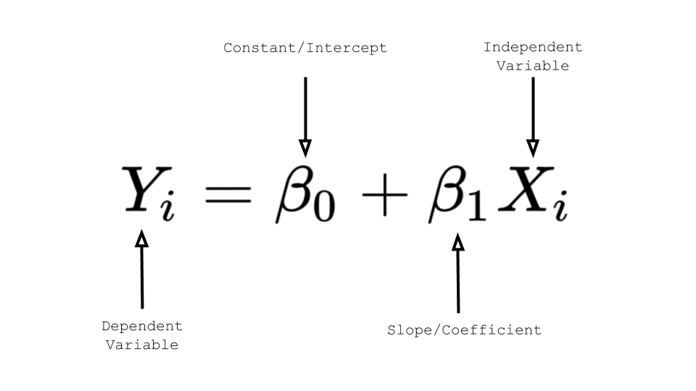
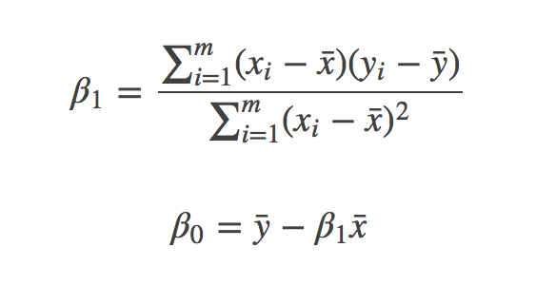
Quantitative data analysis methods
Regression Analysis
Regression analysis is used to estimate the relationship between a set of variables and to determine whether or not there is any correlation between the two. Regression is especially useful for forecasting future trends and making predictions.

Slide 50
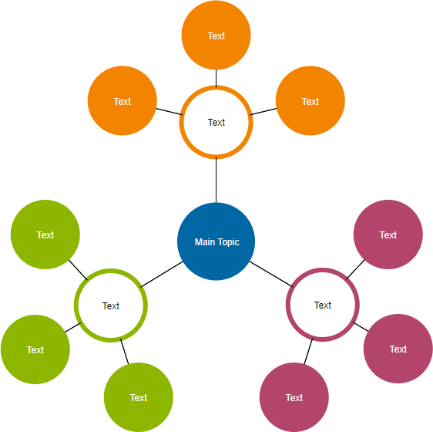
Quantitative data analysis methods
Cluster Analysis
Cluster analysis is an exploratory technique for identifying structures in a dataset. The goal of cluster analysis is to group data points into groups that are internally homogeneous and externally heterogeneous—that is, data points within a cluster are similar to one another but dissimilar to data points in other clusters. Clustering is used as a preprocessing step for other algorithms or to see how data is distributed in a given dataset.

Slide 51
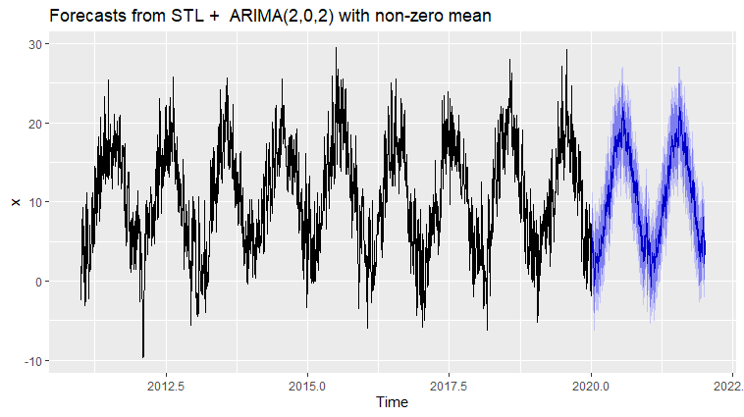
Quantitative data analysis methods
Time Series Analysis
Time series analysis is a technique for identifying trends and cycles over time. Time series data is a collection of data points that measure the same variable over time, such as weekly sales figures or monthly email sign-ups. Analysts can forecast how the variable of interest will fluctuate in the future by examining time-related trends. Extremely useful when making business decisions!

Slide 52
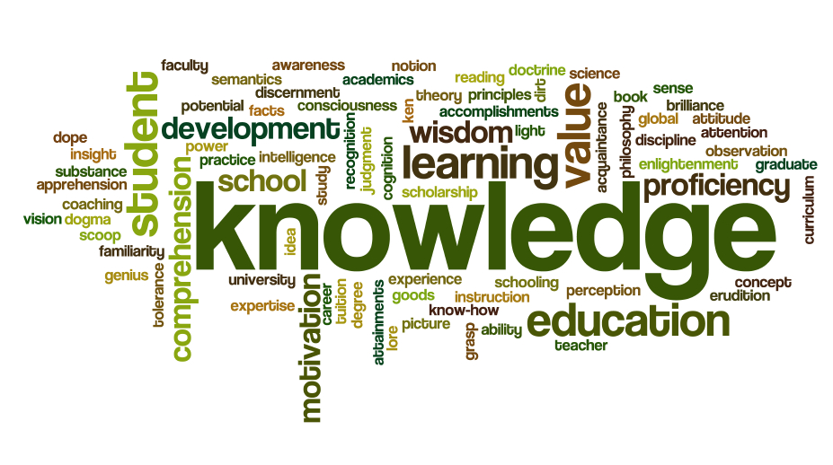
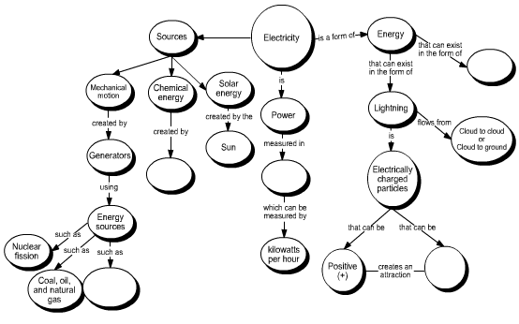
Qualitative Data
Qualitative data is information that cannot be counted, measured, or expressed numerically. It is derived from text, audio, and images and is disseminated using data visualization tools such as word clouds, concept maps, graph databases, timelines, and infographics.

Slide 53
The End
Questions and Answer

Slide 54
TO TALENT
++ Innovation

